Slide 1
Near-Invariant Blur for Depth and 2D Motion via Time-Varying Light Field Analysis
Yosuke Bando^{1,2} Henry Holtzman² Ramesh Raskar²
¹Toshiba Corporation ²MIT Media Lab

Slide 2
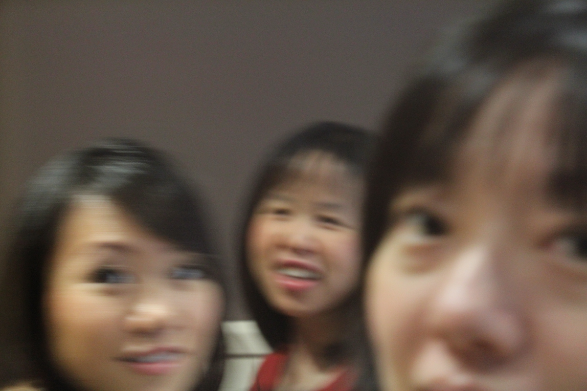
Defocus & Motion Blur
PSF

Slide 3
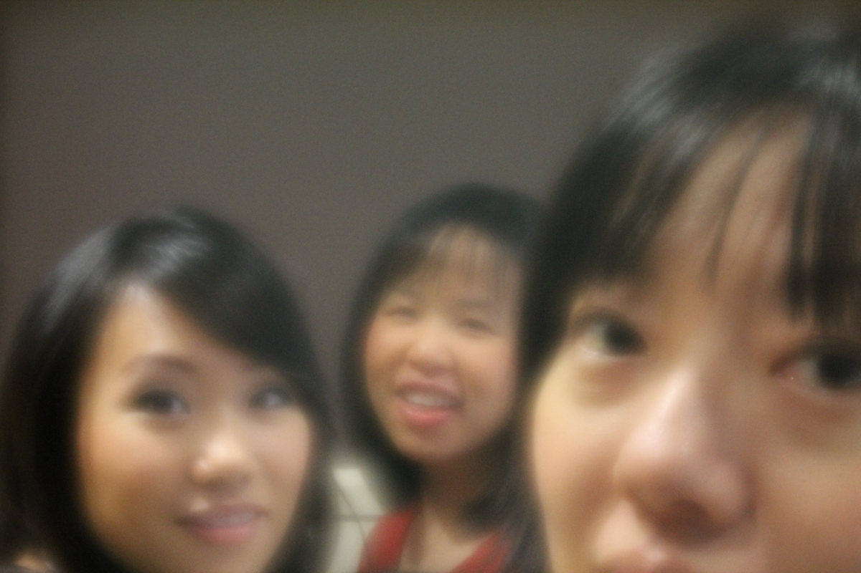
Depth and Motion-Invariant Capture
PSF

Slide 4
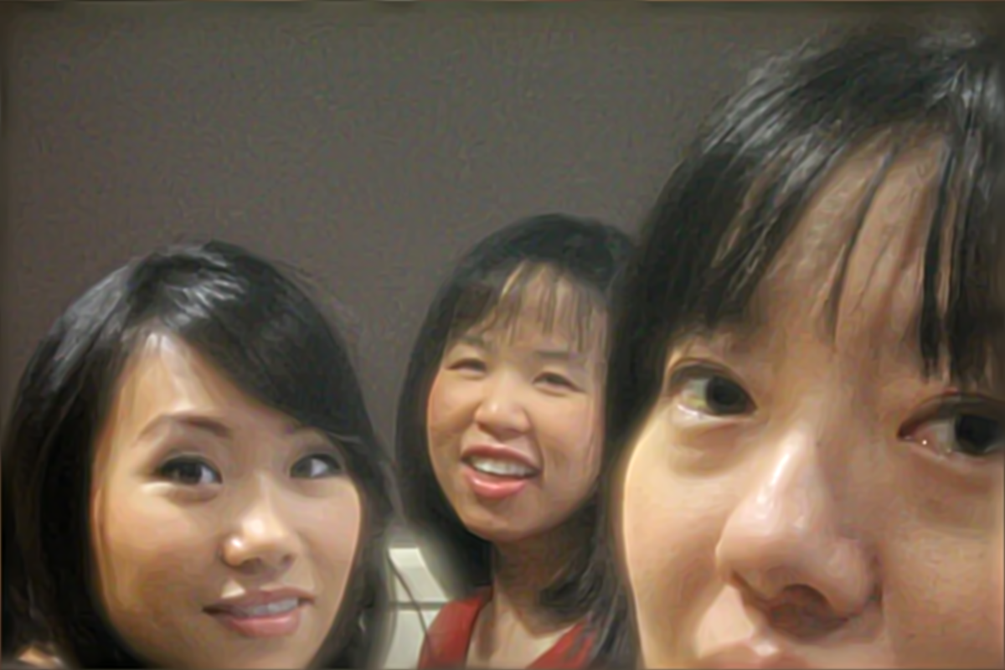
Deblurring Result

Slide 5
Outline
Motivation
Related Work
Intuitions
Analysis
Results
Conclusions

Slide 6
Outline
Motivation
Related Work
Intuitions
Analysis
Results
Conclusions

Slide 7
Joint Defocus & Motion Deblurring
Standard approach
Image
capture
Local blur
estimation
Non-uniform
deblurring
Extremely difficult
Estimate depth and motion from a single image
Recover lost high-frequency content

Slide 8
Joint Defocus & Motion Deblurring
Standard approach
Image
capture
Local blur
estimation
Non-uniform
deblurring
Proposed approach
Depth and 2D motion-
invariant image capture
Uniform
deconvolution
No blur estimation
Well-studied problem

Slide 9
Outline
Motivation
Related Work
Intuitions
Analysis
Results
Conclusions

Slide 10
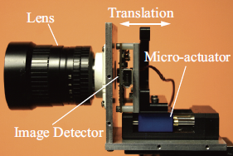
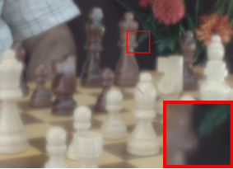
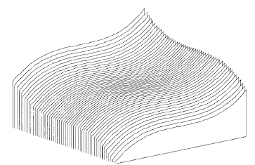
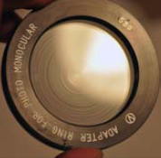
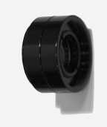
Depth-Invariant Capture
Wavefront coding
[Dowski and Cathey 1995]
Focus sweep
[Hausler 1972;
Nagahara et al. 2008]
Depth-invariant image
Diffusion coding
[Cossairt et al. 2010]
Spectral focus sweep
[Cossairt and Nayar 2010]
Deblurred

Slide 11
1D Motion-Invariant Capture
Invariant to object speed
Motion direction must be fixed
Horizontal, for example
Image
sensor
accelerate
[Levin et al. 2008]
Normal camera
Motion-invariant image
Deblurred

Slide 12
Computational Cameras for Deblurring
 | Defocus deblurring | Motion deblurring
High frequency preservation (non-invariant) | Coded aperture [Levin et al. 2007; Veeraraghavan et al. 2007] Lattice-focal lens [Levin et al. 2009] | Coded exposure [Raskar et al. 2006] Orthogonal parabolic exposures [Cho et al. 2010] Circular sensor motion [Bando et al. 2011]
Invariant capture | Wavefront coding [Dowski and Cathey 1995] Focus sweep [Hausler 1972; Nagahara et al. 2008] Diffusion coding [Cossairt et al. 2010] Spectral focus sweep [Cossairt and Nayar 2010] | Motion-invariant photography (for 1D motion) [Levin et al. 2008]
No joint defocus and motion deblurring
No 2D motion-invariant capture
Also nearly
2D motion-invariant

Slide 13
Outline
Motivation
Related Work
Intuitions
Analysis
Results
Conclusions

Slide 14
Depth-Invariance for Static Point
Plane of focus
Aperture
Sensor
Scene
point
Σ
Time

Slide 15
Depth-Invariance for Static Point
Plane of focus
Aperture
Sensor
Scene
point
Σ
Time

Slide 16
Depth-Invariance for Static Point
Plane of focus
Aperture
Sensor
Scene
point
Σ
Time

Slide 17
Motion-Invariance for Moving Point
Aperture
Sensor
Scene
point
Motion
Σ
Time

Slide 18
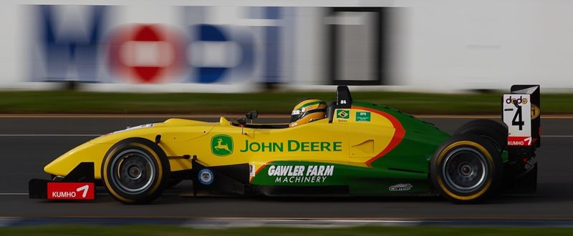
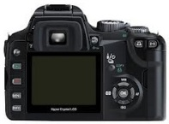
Follow Shot
http://commons.wikimedia.org/wiki/File:Bruno_Senna_2006_Australian_Grand_Prix-3.jpg

Slide 19
Follow Shots for Various Motions
t
x
y

Slide 20
Follow Shots for Various Motions
t
x
y

Slide 21
Follow Shots for Various Motions
t
x
y

Slide 22
Outline
Motivation
Related Work
Intuitions
Analysis
Results
Conclusions

Slide 23
Analysis
Photo is a projection of a light field [Ng 2005]
$$D\left(x_{0}\right)=\iint{k\left(x_{0}−x,−u\right)⋅l\left(x,u\right) dxdu}$$
x = (x, y)
u = (u, v)
Defocus-blurred
image
Light field
kernel
Light field
v
y
Sensor
A
Aperture
b
u
x
Scene point

Slide 24
Analysis
Photo is a projection of a time-varying light field
$$D\left(x_{0}\right)=\iint{k\left(x_{0}−x,−u\right)⋅l\left(x,u\right) dxdu}$$
x = (x, y)
u = (u, v)
Defocus-blurred
image
Light field
kernel
Light field
v
y
Sensor
Velocity
(m_{x}, m_{y})
A
Aperture
b
u
x
Scene point

Slide 25
Analysis
Photo is a projection of a time-varying light field
$$D\left(x_{0}\right)=\iiint{k\left(x_{0}−x,−u, −t\right)⋅l\left(x,u,t\right) dxdudt}$$
x = (x, y)
u = (u, v)
Defocus/motion-
blurred image
Time-varying
light field kernel
Time-varying
light field
v
y
Sensor
Velocity
(m_{x}, m_{y})
A
Aperture
b
u
x
Scene point

Slide 26
Time-Varying Light Field Analysis
Photo is a projection of a time-varying light field
$$D\left(x_{0}\right)=\iiint{k\left(x_{0}−x,−u, −t\right)⋅l\left(x,u,t\right) dxdudt}$$
x = (x, y)
u = (u, v)
Defocus/motion-
blurred image
Time-varying
light field kernel
Time-varying
light field
Lambertian scene at depth s with velocity m = (m_{x}, m_{y})
$$φ_{s,m}\left(x\right)=\iint{k\left(x+su+mt,u, t\right) dudt}$$
Joint defocus &
motion blur PSF
Magnitude of 2D Fourier transform
$${{|\hat{φ}}_{s,m}\left(f_{x}\right)|}^{2}={|\hat{k}\left(f_{x},−sf_{x}, −m⋅f_{x}\right)|}^{2}$$
Modulation transfer function (MTF)

Slide 27
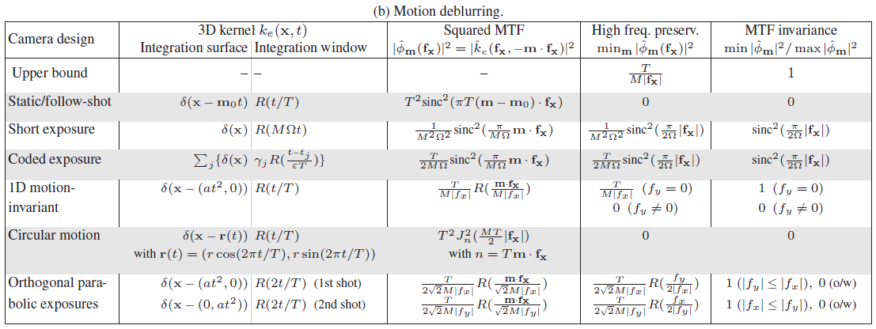
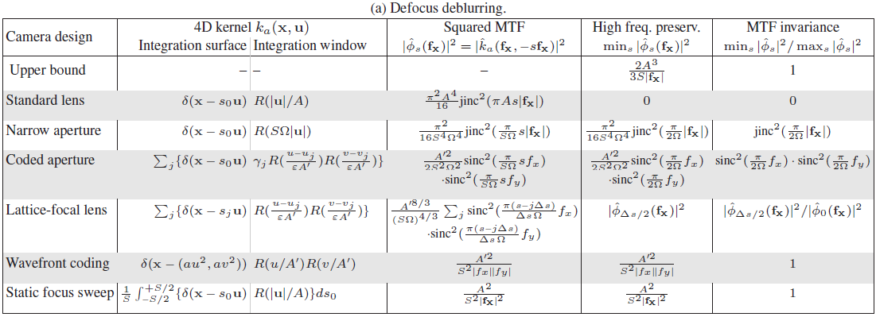
Analysis Procedure and Findings
For each existing computational camera for deblurring
1. derive a kernel equation describing the optical system
2. calculate its Fourier transform to obtain the MTF
3. compare it with the theoretical upper bounds
58%
66%
Better than any other existing computational cameras for deblurring

Slide 28
Outline
Motivation
Related Work
Intuitions
Analysis
Results
Conclusions

Slide 29
Prototype Focus Sweep Camera

Slide 30
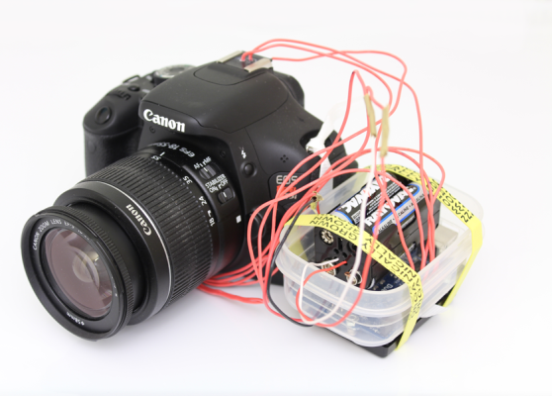
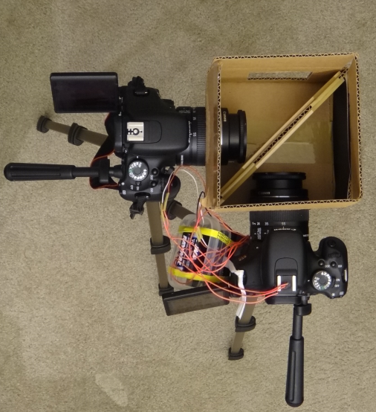
Prototype Camera & Setup
Shutter release
signal
Reference
camera
Scene
Hot shoe
Beam
splitter
SPI command
to move focus
Arduino
+ batteries
Focus
sweep camera

Slide 31
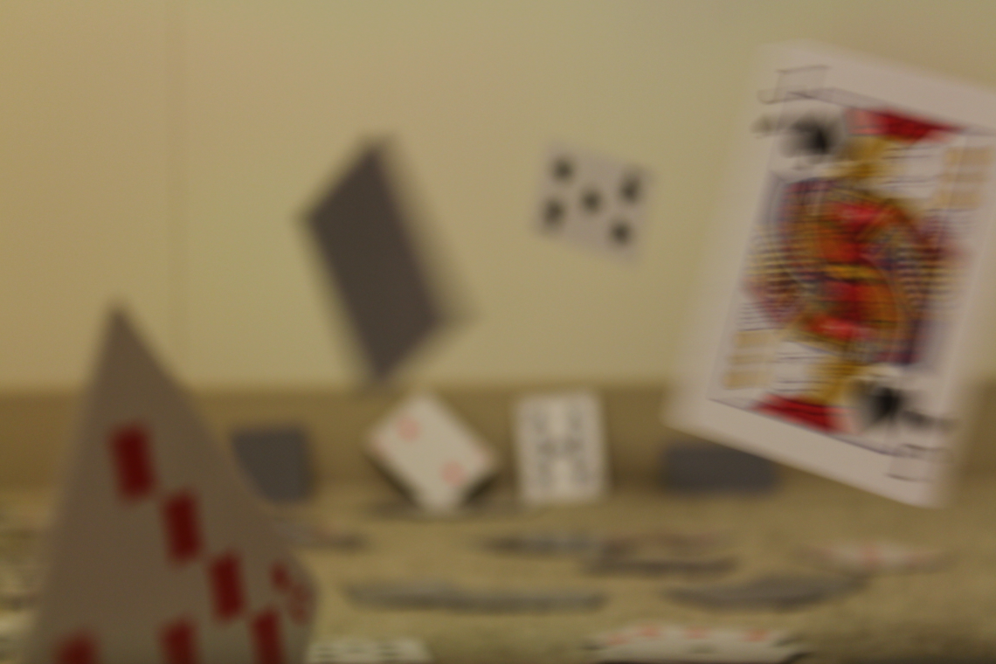
Normal Camera Image
Defocused
Focused
Motion blur
Motion blur

Slide 32
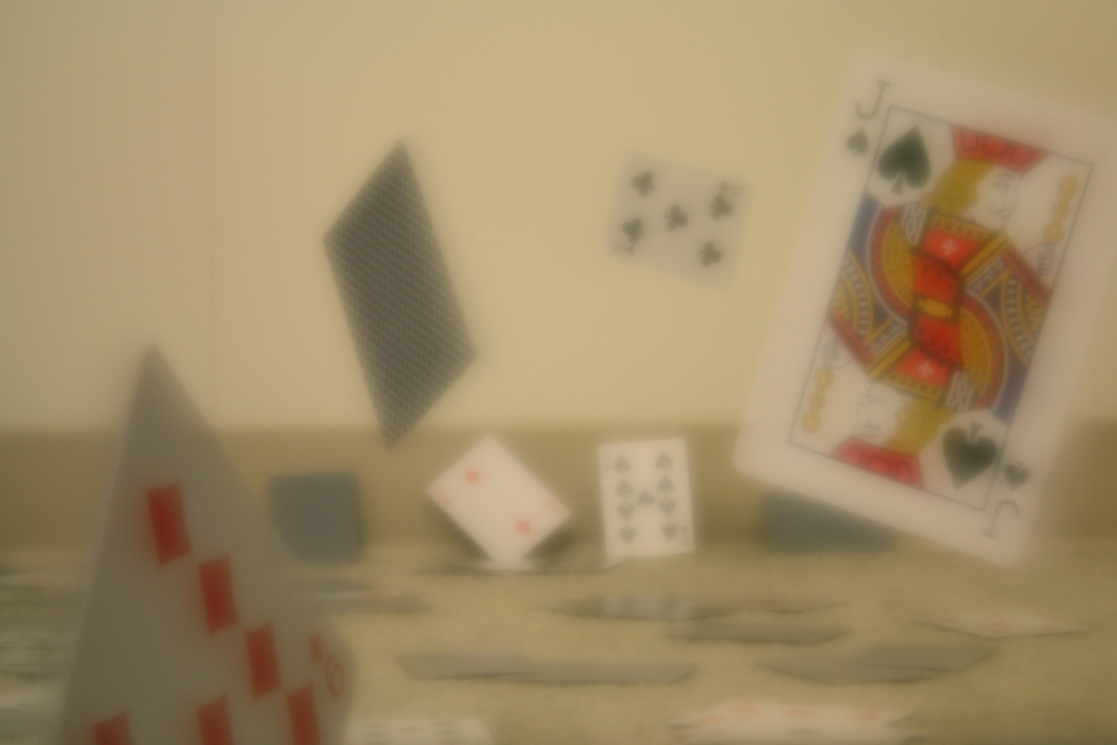
Focus Sweep Image

Slide 33
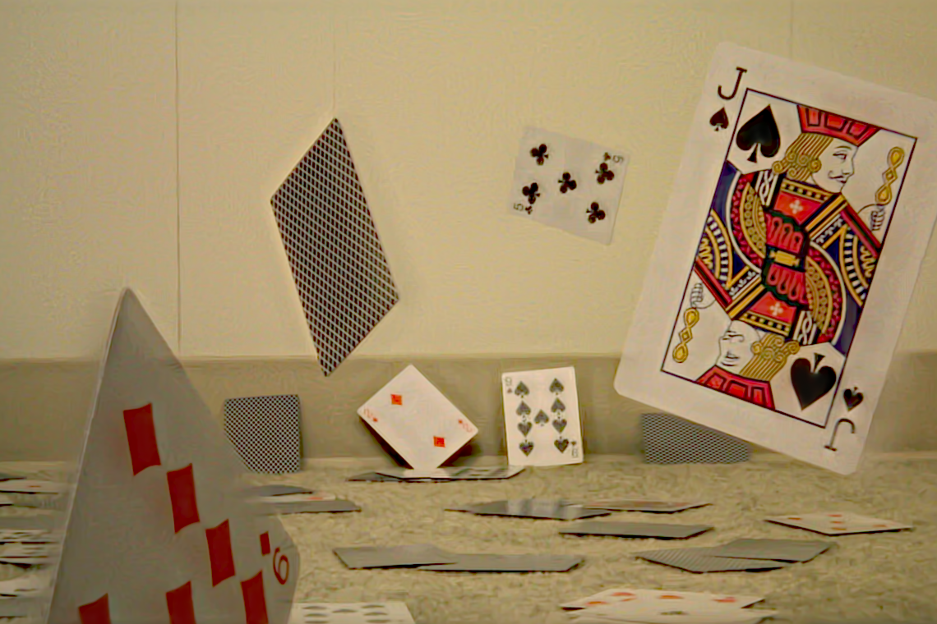
Deconvolution Result

Slide 34
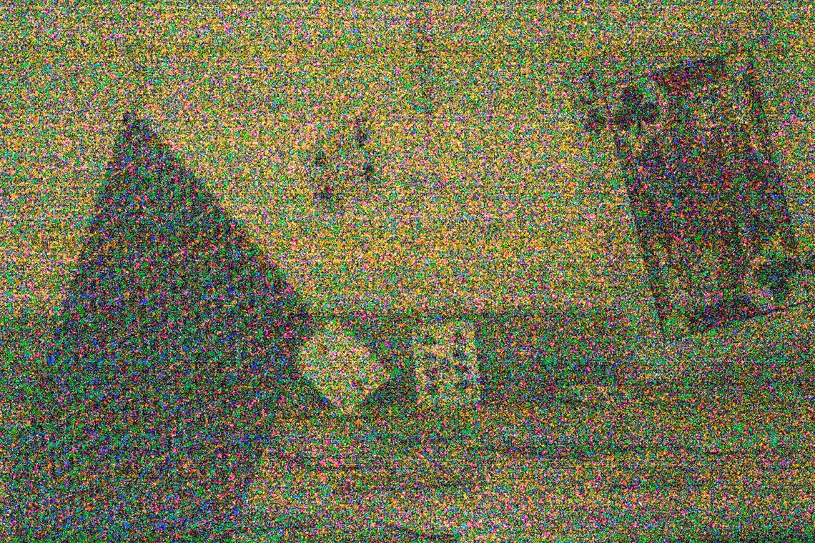
Short Exposure Narrow Aperture Image

Slide 35
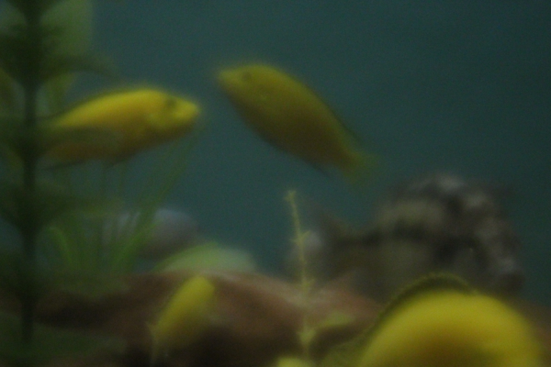
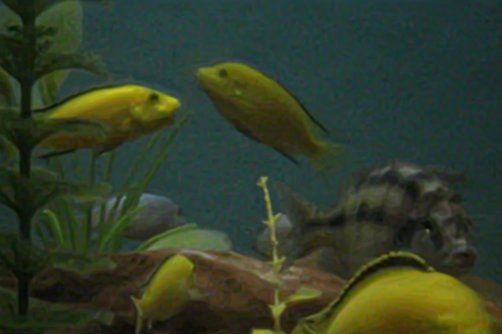
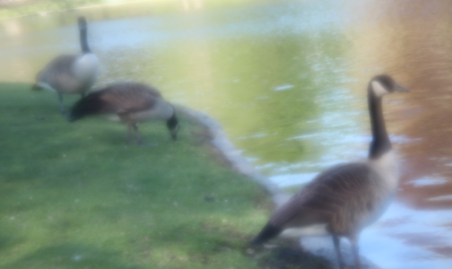
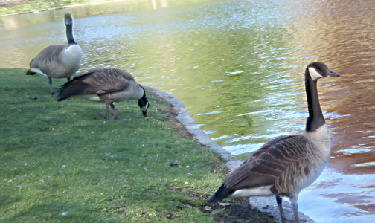
More Examples
Motion
Focus
N/A
Standard camera
Focus sweep
Deconvolution results

Slide 36
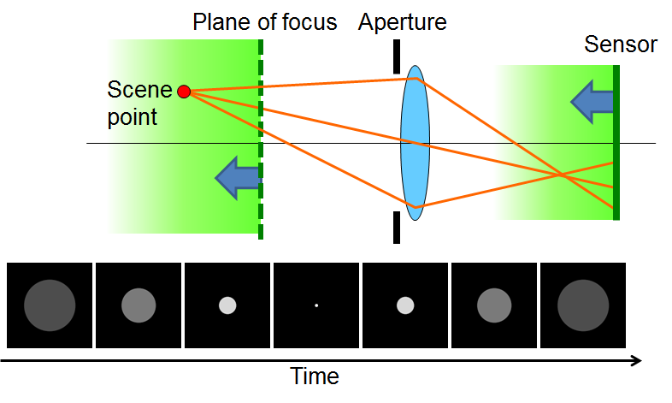
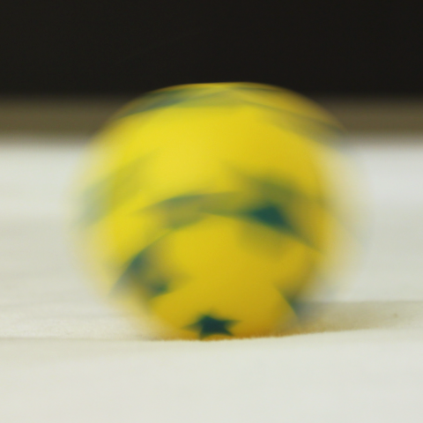
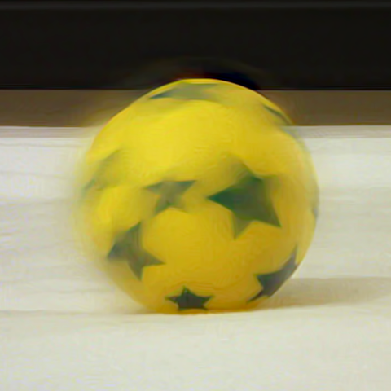
Limitations
Object depth and speed ranges must be bounded
Depth and speed ranges cannot be adjusted separately
Object motion must be in-plane linear
Camera shake cannot be handled
Standard camera
Focus sweep
Deconvolved

Slide 37
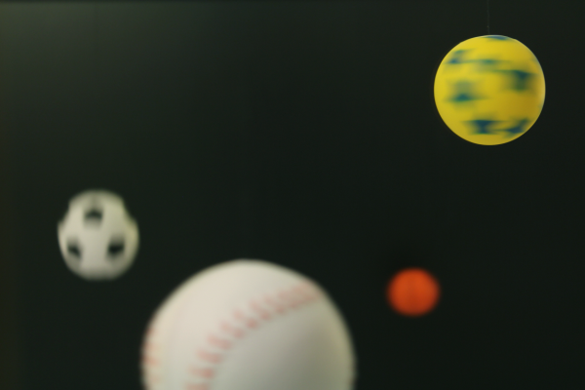
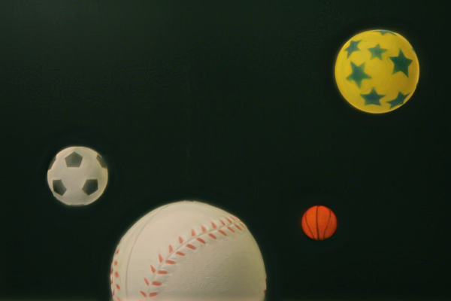
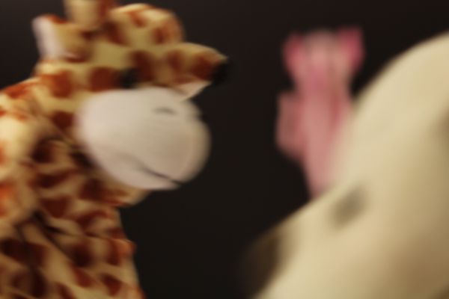
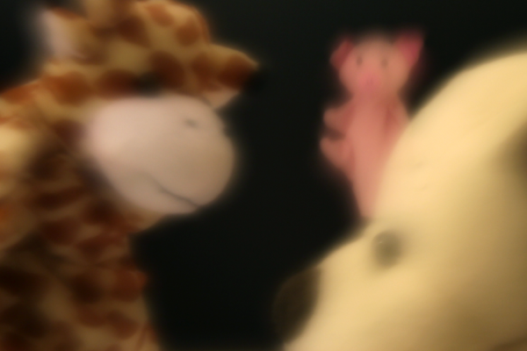
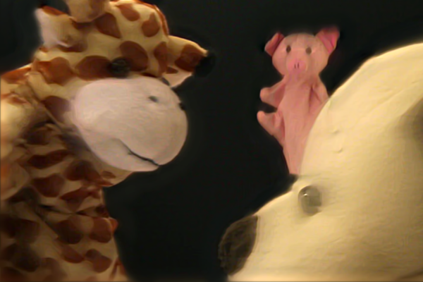
Rotation & Z Motion
Focus
Motion
Motion
Focus
Standard camera
Focus sweep
Deconvolution results

Slide 38
Summary
Simple approach to joint defocus & motion deblurring
No need for estimating scene depth or motion
Also preserves high-frequency image content
Theoretically near-optimal
Has practical implementation (just firmware update)
Standard camera
Focus sweep
Deconvolution results

Slide 39
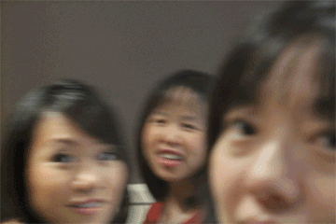
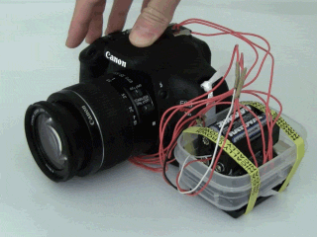
Summary
Simple joint defocus & motion deblurring
No depth or motion estimation
Preserves high-frequency
Theoretically near-optimal
Practical implementation
http://www.media.mit.edu/~bandy/invariant/
How to control the lens
How to achieve perfect invariance
Computational Cameras & Displays 2013
Acknowledgments
Yusuke Iguchi
Noriko Kurachi
Matthew Hirsch,
Matthew O’Toole
Douglas Lanman
Cheryl Sham
Sonia Chang
Shih-Yu Sun
Jeffrey W. Kaeli
Bridger Maxwell
Austin S. Lee
Saori Bando

